Slide 1
CSC6032 – Advanced Operating Systems
Prof. Yeh-Ching Chung
School of Data Science
Chinese University of Hong Kong, Shenzhen

Slide 2
雲端計算 Cloud Computing
Network Virtualization
Open vSwitch

Slide 3
Open vSwitch
Virtual Switch
Open vSwitch architecture
OpenFlow

Slide 4
Virtual Switch
SOFTWARE-BASED VIRTAUL SWITCH
HARDWARE-BASED VIRTAUL SWITCH
VN-Tag

Slide 5
INTRODUCTION
Owing to the emergence of cloud computing service, the number of virtual switches begins to dramatically expand
Management complexity, security issues and even performance degradation
Software/hardware based virtual switch as well as integration of open-source hypervisor with virtual switch technology is exhibited

Slide 6
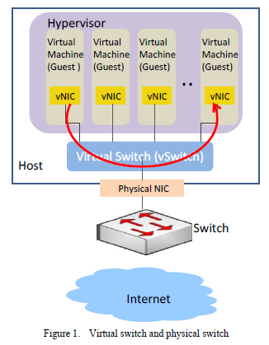
SOFTWARE-BASED VIRTAUL SWITCH
The 80x86 hypervisors implemented vSwitch
Each VM has at least one virtual network interface cards (vNICs) that are sharing physical network interface cards (pNICs) on the physical host through vSwitch
Administrator don’t have effective solution to separate packets from different VM users
For VMs reside in the same physical machine, their traffic visibility is a big issue

Slide 7
Problems of original vSwitch
The original vSwitchs lack of advanced networking features such as VLAN, port mirror and port channel etc.
Nowadays, some hypervisor vSwitch vendors provide technologies to fix the above problems
OpenvSwitch may be superior in quality for the reasons

Slide 8
Virtual Switch
SOFTWARE-BASED VIRTAUL SWITCH
HARDWARE-BASED VIRTAUL SWITCH
VN-Tag

Slide 9
HARDWARE-BASED VIRTAUL SWITCH
Why hardware-based?
Software virtual switches consume CPU and memory usage
Possible inconsistence of network and server configurations may cause errors and is very hard to troubleshooting and maintenance
Hardware-based virtual switch solution emerges for better resource utilization and configuration consistence

Slide 10
Virtual Ethernet Port Aggregator (1/2)
A standardization led by HP, Extreme, IBM, Brocade and Juniper etc.
An emerging technology as part of IEEE 802.1Qbg Edge Virtual Bridge (EVB) standard
The main goal of VEPA is to allow traffic of VM to exit and re-enter the same server physical port to enable switching among VMs

Slide 11
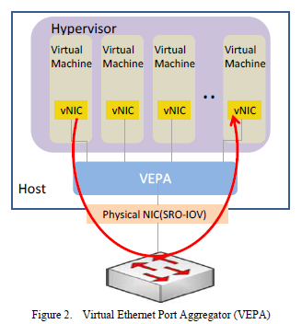
Virtual Ethernet Port Aggregator (2/2)
VEPA software update is required for host servers in order to force packets to be transmitted to external switches
An external VEPA enabled switch is required for communications between VMs in the same server
VEPA supports “hairpin” mode which allows traffic to “hairpin” back out the same port it just received it from--- requires firmware update to existing switches

Slide 12
Pros. and Cons. for VEPA
Pros
Minor software/firmware update , network configuration maintained by external switches
Cons
VEPA still consumes server resources in order to perform forwarding table lookup

Slide 13
Virtual Switch
SOFTWARE-BASED VIRTAUL SWITCH
HARDWARE-BASED VIRTAUL SWITCH
VN-Tag

Slide 14
VN-Tag(1/3)
Proposed by Cisco, adopted by the IEEE as the basis for 802.1Qbh ‘Bridge Port Extension’
A VN-Tag between Layer2 and 802.1Q header is inserted to indicate what path the frame should travel on its way to another VM
The VN-Tag contains two essential fields: the source virtual interface identifier (SVIF_ID) of the sending host and the destination virtual interface identifier (DVIF_ID) of the receiving host

Slide 15
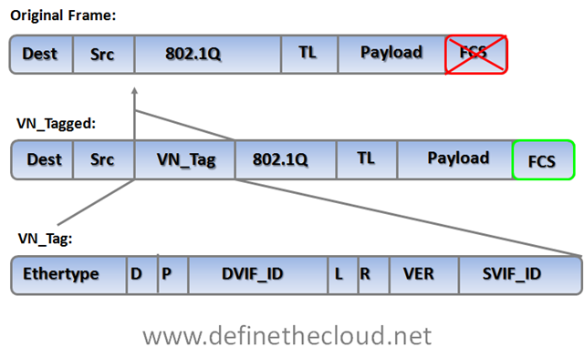
VN-Tag(2/3)
Ethertype | Identifies the VN tag
D | Direction, 1 indicates that the frame is traveling from the bridge to the interface virtualizer (IV.)
P | Pointer, 1 indicates that a vif_list_id is included in the tag.
vif_list_id | A list of downlink ports to which this frame is to be forwarded (replicated). (multicast/broadcast operation)
Dvif_id | Destination vif_id of the port to which this frame is to be forwarded.
L | Looped, 1 indicates that this is a multicast frame that was forwarded out the bridge port on which it was received. In this case, the IV must check the Svif_id and filter the frame from the corresponding port.
R | Reserved
VER | Version of the tag
SVIF_ID | The vif_id of the source of the frame

Slide 16
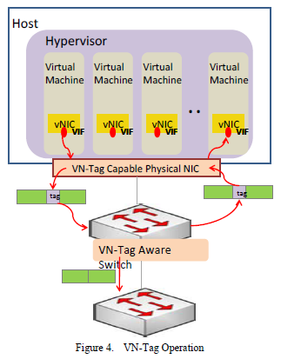
VN-Tag(3/3)
The VN-Tag capable NIC and the VN-Tag aware switch are the necessary
VN-Tag capable physical NIC
Insert Tag at layer2 of the data frame that identify a network packet as part of a specified VM
VN-Tag aware switch
Strip the tag from the frame header at the stage of forwarding to normal switch
Convert a stripped or untagged frame, if the packet is to be transmitted to a VM destination via a VIF port

Slide 17
Pros. and Cons. for VN-Tag
Pros
With VN-Tag technique, the switching will be totally performed by external VN-Tag aware switches
No forwarding decision table will be left in host servers
Cons
The Ethernet frame format is modified
We have to invest new host NICs and external switches in order to recognize VN-Tag

Slide 18
Open vSwitch
Virtual Switch
Open vSwitch architecture
OpenFlow

Slide 19
Open vSwitch architecture
Introduction to Open vSwitch
Main components of Open vSwitch
Open vSwitch Testing Case

Slide 20
Open vSwitch
A software-based solution
Resolve the problems of network separation and traffic visibility, so the cloud users can be assigned VMs with elastic and secure network configurations
Flexible Controller in User-Space
Fast Datapath in Kernel
Server
Open vSwitch Controller
Open vSwitch Datapath

Slide 21
Open vSwitch Concepts(1/2)
Multiple ports to physical switches
A port may have one or more interfaces
Bonding allows more than once interface per port
Packets are forwarded by flow
Visibility
NetFlow
sFlow
Mirroring (SPAN/RSPAN/ERSPAN)
IEEE 802.1Q Support
Enable virtual LAN function
By attaching VLAN ID to Linux virtual interfaces, each user will have its own LAN environment separated from other users

Slide 22
Open vSwitch Concepts(2/2)
Fine-grained ACLs and QoS policies
L2-­‐L4 matching
Actions to forward, drop, modify, and queue
HTB and HFSC queuing disciplines
Centralized control through OpenFlow
Works on Linux-based hypervisors:
Xen
XenServer
KVM
VirtualBox

Slide 23
Open vSwitch Contributors(Partial)

Slide 24
Packets are Managed as Flows(1/2)
A flow may be identied by any combination of
Input port
VLAN ID (802.1Q)
Ethernet Source MAC address
Ethernet Destination MAC address
IP Source MAC address
IP Destination MAC address
TCP/UDP/... Source Port
TCP/UDP/... Destination Port

Slide 25
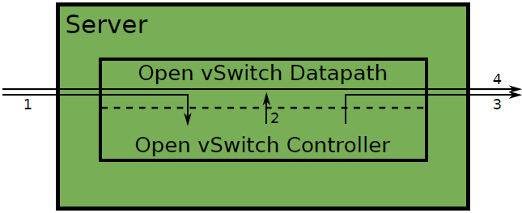
Packets are Managed as Flows(2/2)
The 1rst packet of a flow is sent to the controller
The controller programs the datapath's actions for a flow
Usually one, but may be a list
Actions include:
Forward to a port or ports, mirror
Encapsulate and forward to controller
Drop
And returns the packet to the datapath
Subsequent packets are handled directly by the datapath

Slide 26
Open vSwitch architecture
Introduction to Open vSwitch
Main components of Open vSwitch
Open vSwitch Testing Case

Slide 27
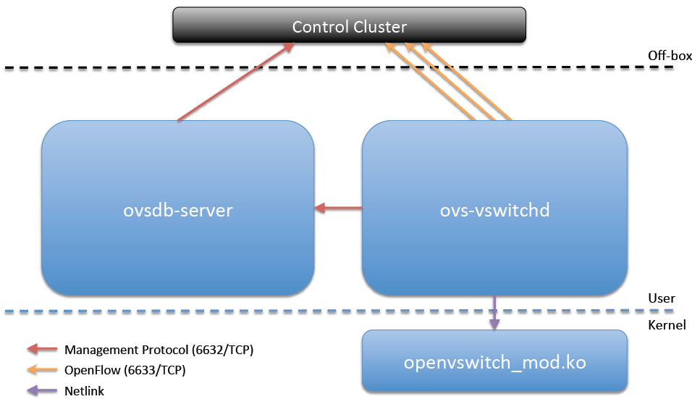
Main Components

Slide 28
ovsdb-­‐server
Database that holds switch--‐level configuration
Custom database with nice properties:
Value constraints
Weak references
Garbage collection
Log--‐based
Speaks management protocol(JSON--‐RPC) to manager and ovs--‐vswitchd

Slide 29
ovs-­‐vswitchd(1/2)
Core component in the system:
Communicates with outside world using OpenFlow
Communicates with ovsdb-­‐server using management protocol
Communicates with kernel module over netlink
Communicates with the system through netdev abstract interface
Supports multiple independent datapaths (bridges)
Packet classiﬁer supports eﬃcient ﬂow lookup with wildcards and “explodes” these (possibly) wildcard rules for fast processing by the datapath

Slide 30
ovs-­‐vswitchd(2/2)
Implements mirroring, bonding, and VLANs through modiﬁcations of the same ﬂow table exposed through OpenFlow
Checks datapath ﬂow counters to handle ﬂow expiration and stats requests

Slide 31
openvswitch_mod.ko
Kernel module that handles switching and tunneling
Exact-­‐match cache of ﬂows
Designed to be fast and simple
Packet comes in, if found, associated actions executed and counters updated. Otherwise, sent to userspace
Does no ﬂow expiration
Knows nothing of OpenFlow
Implements tunnels

Slide 32
Tunneling
Required to provide “true” virtual networks
Focus on performance
Header caching
Hardware oﬄoading
Supported tunneling modes
GRE
GRE-­‐over-­‐IPsec
CAPWAP

Slide 33
Migration
KVM and Xen provide Live Migration
With bridging, IP address migration must occur with in the same L2 network
Open vSwitch avoids this problem using GRE tunnels

Slide 34
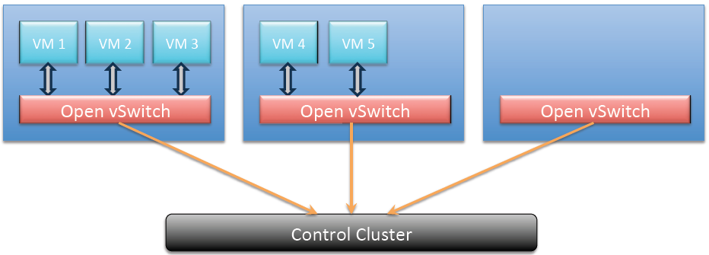
Distributed Virtual Switch

Slide 35
Open vSwitch architecture
Introduction to Open vSwitch
Main components of Open vSwitch
Open vSwitch Testing Case

Slide 36
Virtual LAN
Per-Customer VLANs are desirable for security reasons
But there is a limit of 4094 VLANs

Slide 37
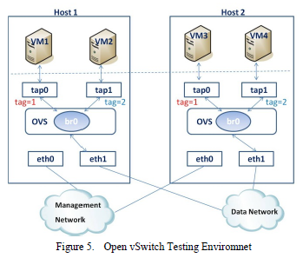
Open vSwitch Testing(1/2)
VM1 and VM3 belong to a user assigned with VLAN ID 1 through tap0 virtual interface; VM2 and VM4 belong to a user assigned with VLAN ID 2 through tap1 virtual interface
Data Network is used for VMs to transmit data packets; Management Network is used for out-of-band management and packet mirroring
On both hosts, we have to install an OVS bridge interface (br0) for performing virtual switch function and attach it with physical Data Network interface eth1

Slide 38

Open vSwitch Testing(2/2)
Attach virtual interfaces of each VM (tap0 and tap1) to the OVS bridge interface (br0) with proper VLAN ID as follows:
Assign VM1~VM4 within the same IP range. Basically, VM1 and VM3 can ping each other and VM2 and VM4 can ping each other successfully
VM1 cannot access VM2 and VM3 cannot access VM4 even they exist on the same host machine

Slide 39
Open vSwitch
Virtual Switch
Open vSwitch architecture
OpenFlow

Slide 40
OpenFlow
Introduction to OpenFlow
OpenFlow Switching
Usage models
Virtualizing OpenFlow
FlowVisor-based Virtualization
OpenFlow references

Slide 41
OpenFlow
Idealized view of a switch’s datapath
Centralized controller conﬁgures ﬂow table
Lookup based on L2-­‐L4
Supports full wildcarding and priorities
Flows associated with actions: forward, drop, modify
Missed ﬂows go to controller
Remote visibility
Description of switch (supported actions, ﬂow tables’ sizes, etc.)
Statistics (ﬂows, tables, ports)

Slide 42
Nicira Extensions to OpenFlow
Resubmit
NXM (Extensible Match)
Tunnels
Registers
IPv6
Labels used by new actions
Flexible tunnel tagging
Multiple controllers
Separate setting a QoS queue from transmitting
Multipathing

Slide 43
Dynamic Flow Aggregation on an OpenFlow Network(1/2)
Scope
Different Networks want different flow granularity (ISP, Backbone,…)
Switch resources are limited (flow entries, memory)
Network management is hard
Current Solutions : MPLS, IP aggregation

Slide 44
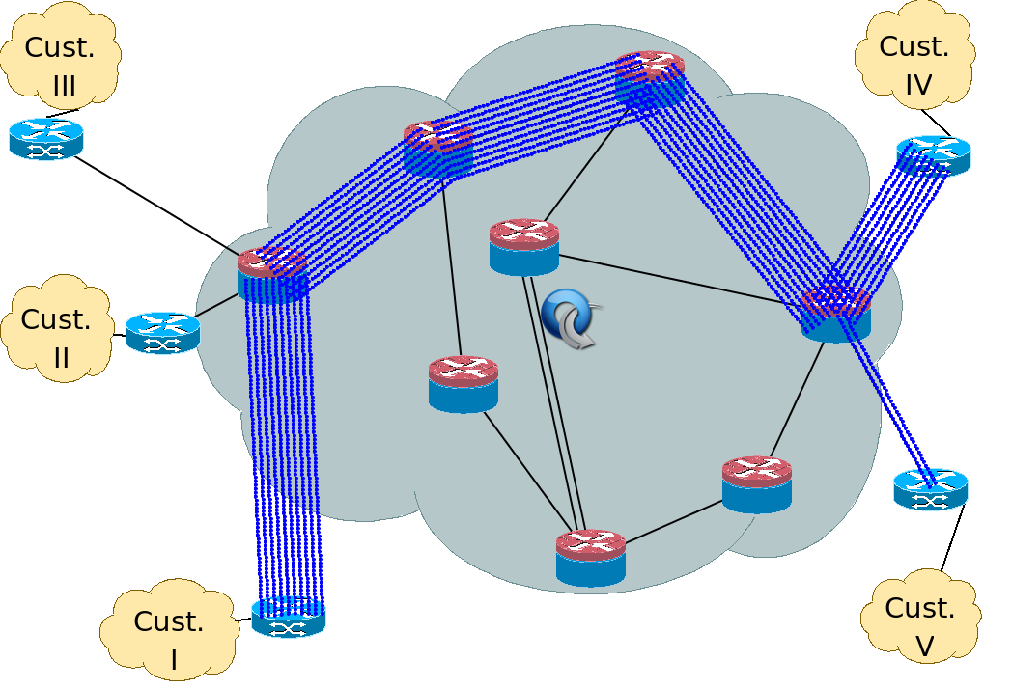
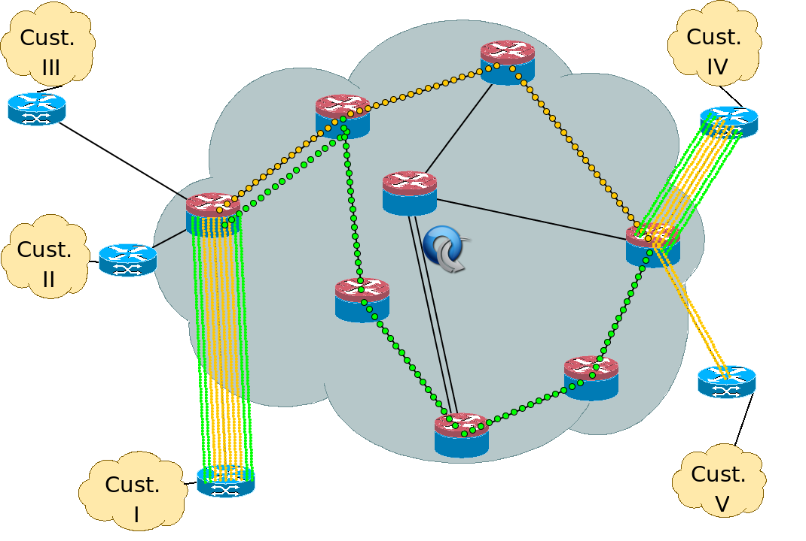
Dynamic Flow Aggregation on an OpenFlow Network(2/2)
How do OpenFlow Help?
Dynamically define flow granularity by wildcarding arbitrary header fields
Granularity is on the switch flow entries, no packet rewrite or encapsulation
Create meaningful bundles and manage them using your own software (reroute, monitor)

Slide 45
OpenFlow
Introduction to OpenFlow
OpenFlow Switching
Usage models
Virtualizing OpenFlow
FlowVisor-based Virtualization
OpenFlow references

Slide 46
OpenFlow Switching
A way to run experiments in the networks
Bring GENI to college campuses
A “pragmatic” compromise
Allow researchers to run experiments in their network without requiring vendors to expose internal workings
Basic requirements
An Ethernet switch (e.g. 128-ports of 1GE)
An open protocol to remotely add/remove flow entries

Slide 47

Experimenter’s Dream (Vendor’s Nightmare)
Standard
Network
Processing
User-
defined
Processing
sw
Experimenter writes experimental code on switch/router
hw

Slide 48
No obvious way
Commercial vendor won’t open software and hardware development environment
Complexity of support
Market protection and barrier to entry
Hard to build my own
Prototypes are flakey
Software only: Too slow
Hardware/software: Fanout too small (need >100 ports for wiring closet)

Slide 49
Furthermore, we need…
Isolation
Regular production traffic untouched
Virtualized and programmable
Different flows processed in different ways
Equipment we can trust in our wiring closet
Open development environment for all researchers (e.g. Linux, Verilog, etc).
Flexible definitions of a flow
Individual application traffic
Aggregated flows
Alternatives to IP running side-by-side
…

Slide 50

OpenFlow Switching
Controller
OpenFlow Switch
OpenFlow Switch specification
OpenFlow
Protocol
PC
SSL
Secure
Channel
sw
Flow
Table
hw

Slide 51
Flow Table Entry “Type 0” OpenFlow Switch
Rule
Action
Stats
Packet + byte counters
Forward packet to port(s)
Encapsulate and forward to controller
Drop packet
Send to normal processing pipeline
Switch
Port
MAC
src
MAC
dst
Eth
type
VLAN
ID
IP
Src
IP
Dst
IP
Prot
TCP
sport
TCP
dport
+ mask

Slide 52
Examples(1/2)
Switching
Switch
Port
MAC
src
MAC
dst
Eth
type
VLAN
ID
IP
Src
IP
Dst
IP
Prot
TCP
sport
TCP
dport
Action
*
*
00:1f:..
*
*
*
*
*
*
*
port6
Flow Switching
Switch
Port
MAC
src
MAC
dst
Eth
type
VLAN
ID
IP
Src
IP
Dst
IP
Prot
TCP
sport
TCP
dport
Action
port3
00:20..
00:1f..
0800
vlan1
1.2.3.4
5.6.7.8
4
17264
80
port6
Firewall
Switch
Port
MAC
src
MAC
dst
Eth
type
VLAN
ID
IP
Src
IP
Dst
IP
Prot
TCP
sport
TCP
dport
Action
*
*
*
*
*
*
*
*
*
22
drop

Slide 53
Examples(2/2)
Routing
Switch
Port
MAC
src
MAC
dst
Eth
type
VLAN
ID
IP
Src
IP
Dst
IP
Prot
TCP
sport
TCP
dport
Action
*
*
*
*
*
*
5.6.7.8
*
*
*
port6
VLAN Switching
Switch
Port
MAC
src
MAC
dst
Eth
type
VLAN
ID
IP
Src
IP
Dst
IP
Prot
TCP
sport
TCP
dport
Action
port6,
port7,
port9
*
*
00:1f..
*
vlan1
*
*
*
*
*

Slide 54
OpenFlow “Type 1”
Additional actions
Rewrite headers
Map to queue/class
Encrypt
More flexible header
Allow arbitrary matching of first few bytes
Support multiple controllers
Load-balancing and reliability

Slide 55
Secure Channel
SSL Connection, site-specific key
Controller discovery protocol
Encapsulate packets for controller
Send link/port state to controller

Slide 56

Server room
OpenFlow
Access Point
OpenFlow
Controller
PC
OpenFlow-enabled
Commercial Switch
OpenFlow
OpenFlow
Normal
Software
Secure
Channel
Normal
Datapath
Flow
Table

Slide 57
OpenFlow
Introduction to OpenFlow
OpenFlow Switching
Usage models
Virtualizing OpenFlow
FlowVisor-based Virtualization
OpenFlow references

Slide 58
OpenFlow Usage Models(1/2)
Experiments at the flow level
User-defined routing protocols
Admission control
Network access control
Network management
Energy management
VOIP mobility and handoff
…
Experiments at the packet level
Slow: Controller handles packet processing
Fast: Redirect flows through programmable hardware
Modified routers, firewalls, NAT, congestion control…
Alternatives to IP
Experiment-specific controllers
Static or dynamic flow-entries

Slide 59

Example Experiment at the flow level Mobility
Lots of interesting questions
Management of flows
Control of switches
Access control of users and devices
Tracking user location and motion

Slide 60
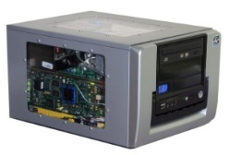
Experiments at the packet level
Controller
PC
OpenFlow-enabled
Commercial Switch
Normal
Software
Secure
Channel
Normal
Datapath
Flow
Table
Laboratory
NetFPGA

Slide 61
OpenFlow Usage Models(2/2)
Experiments at the flow level
Experiments at the packet level
Alternatives to IP
Flow-table is Layer-2 based
e.g. new naming and addressing schemes
…

Slide 62
OpenFlow
Introduction to OpenFlow
OpenFlow Switching
Usage models
Virtualizing OpenFlow
FlowVisor-based Virtualization
OpenFlow references

Slide 63
Network Virtualization
Network Operators “Delegate” control of subsets of network hardware and/or traffic to other Network Operators or Users
Multiple Controllers can talk to same set of switches
Imagine a Hypervisor for network equipment
Allows experiments to be run on the network in isolation of each other and production traffic

Slide 64
Trend
App
App
App
App
App
App
Controller 1
Controller
2
Windows
(OS)
Linux
Mac
OS
Controller 1
Controller
2
Windows
(OS)
Linux
Mac
OS
NOX
(Network OS)
Network OS
Windows
(OS)
Linux
Mac
OS
Virtualization layer
Virtualization or “Slicing”
x86
(Computer)
OpenFlow
Computer Industry
Network Industry
Notes:
Hidden slide (just for backup reasons)
Shows how far along we can go in opening up the network
64

Slide 65
Isolated “slices”
Many operating systems, or
Many versions
App
App
App
App
App
App
App
App
Network Operating System 1
Network Operating System 2
Network Operating System 3
Network Operating System 4
Open interface to hardware
Virtualization or “Slicing” Layer
Open interface to hardware
Simple Packet Forwarding Hardware
Simple Packet Forwarding Hardware
Simple Packet Forwarding Hardware
Simple Packet Forwarding Hardware
Simple Packet Forwarding Hardware

Slide 66

Switch Based Virtualization Exists for NEC, HP switches but not flexible enough
Research VLAN 2
Flow Table
Controller
Research VLAN 1
Flow Table
Controller
Production VLANs
Normal L2/L3 Processing
Notes:
Experiments running on PRODUCTION infrastructure
Key to get scale, key to get traffic on the network
(e.g. can’t just do a reset...)

Slide 67
OpenFlow
Introduction to OpenFlow
OpenFlow Switching
Usage models
Virtualizing OpenFlow
FlowVisor-based Virtualization
OpenFlow references

Slide 68
FlowVisor
Network Hypervisor developed by Stanford
A software proxy between the forwarding and control planes of network devices

Slide 69




FlowVisor-based Virtualization(1/2)
Heidi’s
Controller
Craig’s
Controller
Aaron’s
Controller
Topology discovery is per slice
OpenFlow
Protocol
OpenFlow
Switch
OpenFlow FlowVisor & Policy Control
OpenFlow
Protocol
OpenFlow
Switch
OpenFlow
Switch
69

Slide 70
FlowVisor-based Virtualization(2/2)
http
Load-balancer
Broadcast
Multicast
Separation not only
by VLANs, but any
L1-L4 pattern
dl_dst=FFFFFFFFFFFF
OpenFlow
Protocol
tp_src=80, or tp_dst=80
OpenFlow
Switch
OpenFlow
FlowVisor & Policy Control
OpenFlow
Protocol
OpenFlow
Switch
OpenFlow
Switch

Slide 71
FlowVisor Slicing
Slices are defined using a slice definition policy
The policy language specifies the slice’s resource limits, flowspace, and controller’s location in terms of IP and TCP port-pair
FlowVisor enforces transparency and isolation between slices by inspecting, rewriting, and policing OpenFlow messages as they pass

Slide 72
FlowVisor Resource Limits
FV assigns hardware resources to “Slices”
Topology
Network Device or Openflow Instance (DPID)
Physical Ports
Bandwidth
Each slice can be assigned a per port queue with a fraction of the total bandwidth
CPU
Employs Course Rate Limiting techniques to keep new flow events from one slice from overrunning the CPU
Forwarding Tables
Each slice has a finite quota of forwarding rules per device

Slide 73
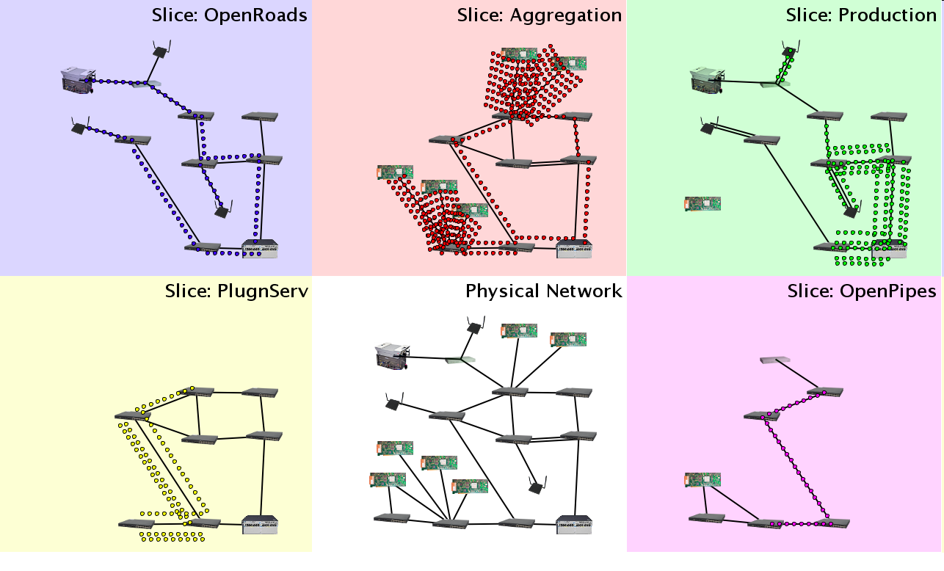
Slicing
Notes:
Carves Network into “Slices” and Assigns hardware resources to each slice. Switch DPID, Port.

Slide 74
FlowVisor FlowSpace
FlowSpace is defined by a collection of packet headers and assigned to “Slices”
Src/Dst MAC Address
VLAN ID
Ethertype
IP Protocol
Src/Dst IP Address
ToS/DSCP
Src/Dst Port Number

Slide 75
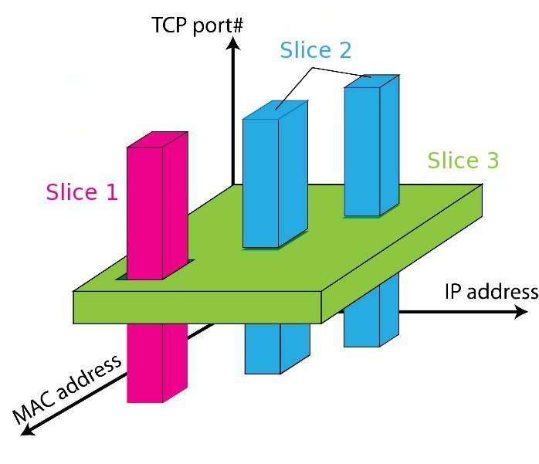
FlowSpace: Maps Packets to Slices

Slide 76
FlowVisor Slicing Policy(1/2)
FV intercepts OF messages from devices
FV only sends control plane messages to the Slice controller if the src device is in the Slice Topology.
Rewrites OF feature negotiation messages so the slice controller only sees the ports in it’s slice
Port up/down messages are pruned and only forwarded to affected slices

Slide 77
FlowVisor Slicing Policy(2/2)
FV intercepts OF messages from controllers
Rewrites Flow Insertion, Deletion & Modifications so they don’t violate the slice definition
Flow definition – ex. Limit Control to HTTP traffic only
Actions – ex. Limit forwarding to only ports in the slice
Expand Flow rules into multiple rules to fit policy
Flow definition – ex. If there is a policy for John’s HTTP traffic and another for Uwe’s HTTP traffic, FV would expand a single rule intended to control all HTTP traffic into 2 rules.
Actions – ex. Rule action is send out all ports. FV will create one rule for each port in the slice.
Returns “action is invalid” error if trying to control a port outside of the slice

Slide 78
FlowVisor Message Handling
Alice
Controller
Bob
Controller
Cathy
Controller
Rule
OpenFlow
Policy Check:
Is this rule allowed?
Policy Check:
Who controls this packet?
FlowVisor
OpenFlow
Full Line Rate
Forwarding
OpenFlow
Firmware
Exception
Packet
Data Path
Packet

Slide 79
OpenFlow
Introduction to OpenFlow
OpenFlow Switching
Usage models
Virtualizing OpenFlow
FlowVisor-based Virtualization
OpenFlow references

Slide 80
OpenFlow Consortium
http://OpenFlowSwitch.org
Goal
Evangelize OpenFlow to vendors
Free membership for all researchers
Whitepaper, OpenFlow Switch Specification, Reference Designs
Licensing: Free for research and commercial use

Slide 81
OpenFlow building blocks
oftrace
oflops
openseer
Monitoring/ debugging tools
Stanford Provided
ENVI (GUI)
LAVI
n-Casting
Expedient
Applications
NOX
Beacon
Trema
Maestro
ONIX
Controller
Slicing
Software
FlowVisor
Console
FlowVisor
Commercial Switches
Stanford Provided
Software
Ref. Switch
NetFPGA
Broadcom
Ref. Switch
HP, NEC, Pronto, Juniper.. and many more
OpenFlow
Switches
OpenWRT
PCEngine WiFi AP
Open vSwitch
81
Notes:
There are components at different levels that work together in making it work
The commercial switch details will follow in next slide
There are a plethora of applications possible. I only list those available at Stanford

Slide 82
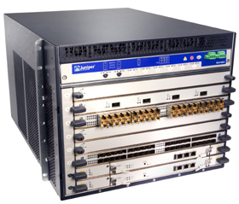
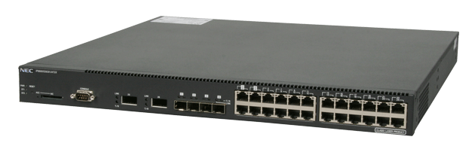
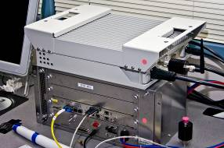
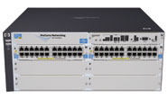
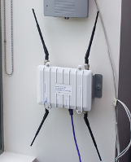

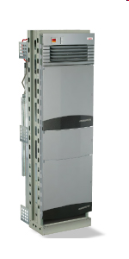

Current SDN hardware
Juniper MX-series
NEC IP8800
WiMax (NEC)
HP Procurve 5400
Netgear 7324
PC Engines
Pronto 3240/3290
Ciena Coredirector
Ask your vendors
82

Slide 83
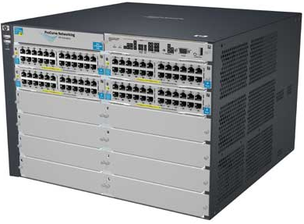

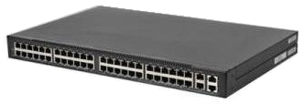
Commercial Switch Vendors
Model | Virtualize | Notes
HP Procurve 5400zl or 6600 | 1 OF instance per VLAN | LACP, VLAN and STP processing before OpenFlow Wildcard rules or non-IP pkts processed in s/w Header rewriting in s/w CPU protects mgmt during loop
NEC IP8800 | 1 OF instance per VLAN | OpenFlow takes precedence Most actions processed in hardware MAC header rewriting in h/w
Pronto 3240 or 3290 with Pica8 or Indigo firmware | 1 OF instance per switch | No legacy protocols (like VLAN and STP) Most actions processed in hardware MAC header rewriting in h/w
83
Notes:
All support ver 1.0
All have approx 1500 flow table entry limit

Slide 84
OpenFlow Controllers
Name | Lang | Platform(s) | License | Original Author | Notes
OpenFlow Reference | C | Linux | OpenFlow License | Stanford/Nicira | not designed for extensibility
NOX | Python, C++ | Linux | GPL | Nicira | actively developed
Beacon | Java | Win, Mac, Linux, Android | GPL (core), FOSS Licenses for your code | David Erickson (Stanford) | runtime modular, web UI framework, regression test framework
Maestro | Java | Win, Mac, Linux | LGPL | Zheng Cai (Rice)
Trema | Ruby, C | Linux | GPL | NEC | includes emulator, regression test framework
RouteFlow | ? | Linux | Apache | CPqD (Brazil) | virtual IP routing as a service
Notes:
Language open-source Performance cross-platform runtime modular

Slide 85














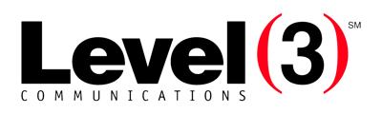










Growing Community
Vendors and start-ups
Providers and business-unit
More...
More...
Note: Level of interest varies
85

Slide 86
Related Research
DIFANE
Rule partitioning for controller-less flow insertion
UCSD Fat Tree Series: Scalable Commodity Data Center, PortLand, Hedera
Scale-out data centers that use OpenFlow
Tesseract
Centralized WAN in the 4D Architecture
ONIX
Fault-tolerant controller platform from Nicira, Google, NEC
DevoFlow
Practical scalability limits to OpenFlow and modifications to get around them

Slide 87
References
Network Virtualization with Cloud Virtual Switch
S. Horman, “An Introduction to Open vSwitch,” LinuxCon Japan, Yokohama, Jun. 2, 2011.
J. Pettit, J. Gross “Open vSwitch Overview,” Linux Collaboration Summit, San Francisco, Apr. 7, 2011.
J. Pettit, “Open vSwitch: A Whirlwind Tour,” Mar. 3, 2011.
Access Layer Network Virtualization: VN-Tag and VEPA
OpenFlow Tutorial

